Slide 1
NETWORK TOPOLOGY FOR CORE AND RAN DEPLOYMENT
Aditya Zodpe
Swetha Vijaya Raghavan

Slide 2
ORCHESTERATION AND MANAGEMENT
Service delivery, design and run time frameworks, using common information model based service definitions
Multi-domain Service Orchestration (spanning across administrative and also operator domains)
Consistent inventory (of services, resources, infrastructure and geo/topology)
End-to-end Service Assurance including FCAPS (Fault, Configuration, Accounting, Performance, Security) with automated Analytics (AI supported)
Security (trusted platform, OS and application layers, tenant privacy and isolation)
Implement
Fully autonomous management,
Orchestration system

Slide 3
COMMON INFORMATION MODEL
Build and operate
multi-domain,
multi-vendor network,
even support cross operator network services,
the service and resource orchestrators need to work with common data models.
Standardized Service and Network Function modeling and packaging
enables faster lifecycle management of new 5G services.
An Information model
conceptual/abstract model for designers and operators
Data model
concrete and detailed model for implementers of the information
models.

Slide 4
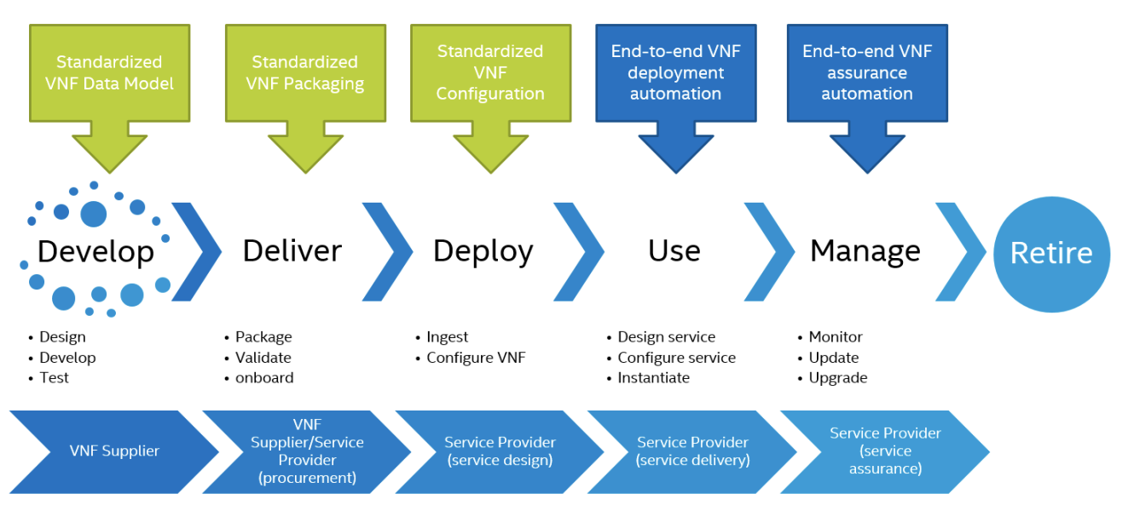
Figure 1. Enabling VNF Life Cycle Automation

Slide 5
NETWORK SLICING
Include a fine-grained allocation of resources
compute memory and disk space, in addition to network separation.
Represents dynamic and logically independent application delivery infrastructure (IaaS).
The intention
traffic treatment that is necessary for the use case, and avoid all other unnecessary functionality.
The flexibility
key enabler to both expand existing businesses and create new businesses.
NFV MANO functions need to be complemented and interwork with the network slice management functions.
consume the APIs exposed by the NFV Orchestration (NFVO) layer as well as other APIs exposed by other management entities enabling full FCAPS of the network functions involved in the instance of that network slice.
Network slice management can be viewed as a functional area that needs to be standardized on top of NFV

Slide 6
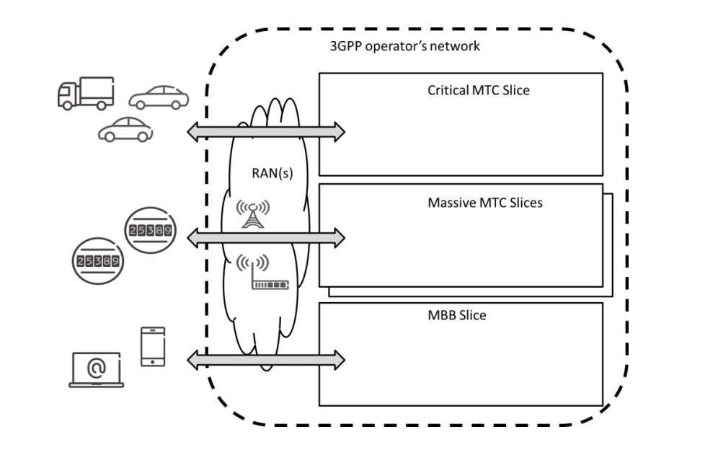
Figure 2. Network Slicing mechanism catering for different use cases at operator’s network

Slide 7
TOWARDS COGNITIVE ANALYTICS
Static measurements of network and application performance will not be capable to surveil the dynamic landscape of SDN/NFV based 5G networks and functions.
The pace at which environments change,
requires sophisticated analysis of real-time counters,
telemetry streaming,
flow-based information in combination with user profile and behavior data.
Creating a dynamic model to correlate the resulting big data, requires AI/ML technology that will pave the way from today’s transaction process based analytics towards predictive, descriptive and finally cognitive analytics required for self-optimizing, self-healing networks and applications.

Slide 8
